Slide 1
Introduction to Image recognition with Artificial Neural Net
Simon Johansson

Slide 2
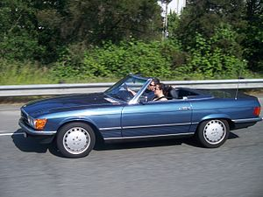

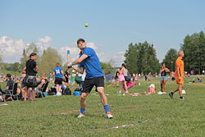
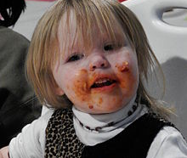
Intelligence Ability to learn
Intelligence Ability to learn
Notes:
For a quite

Slide 3
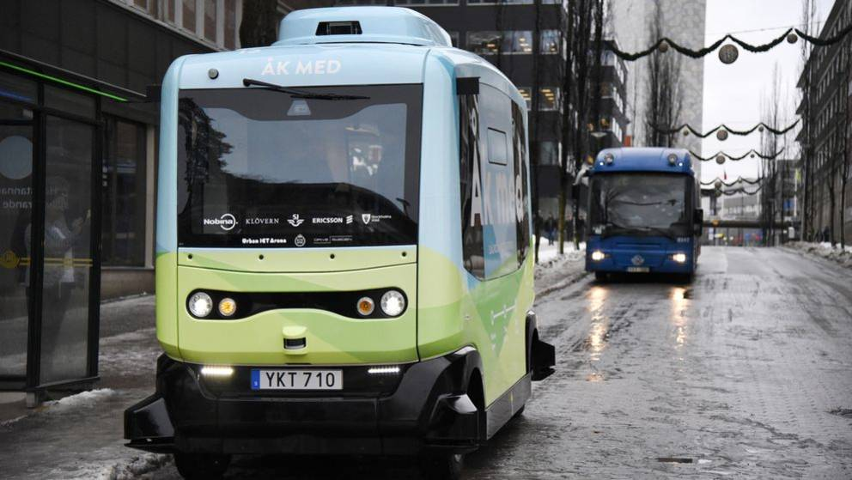
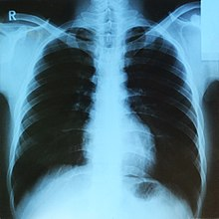
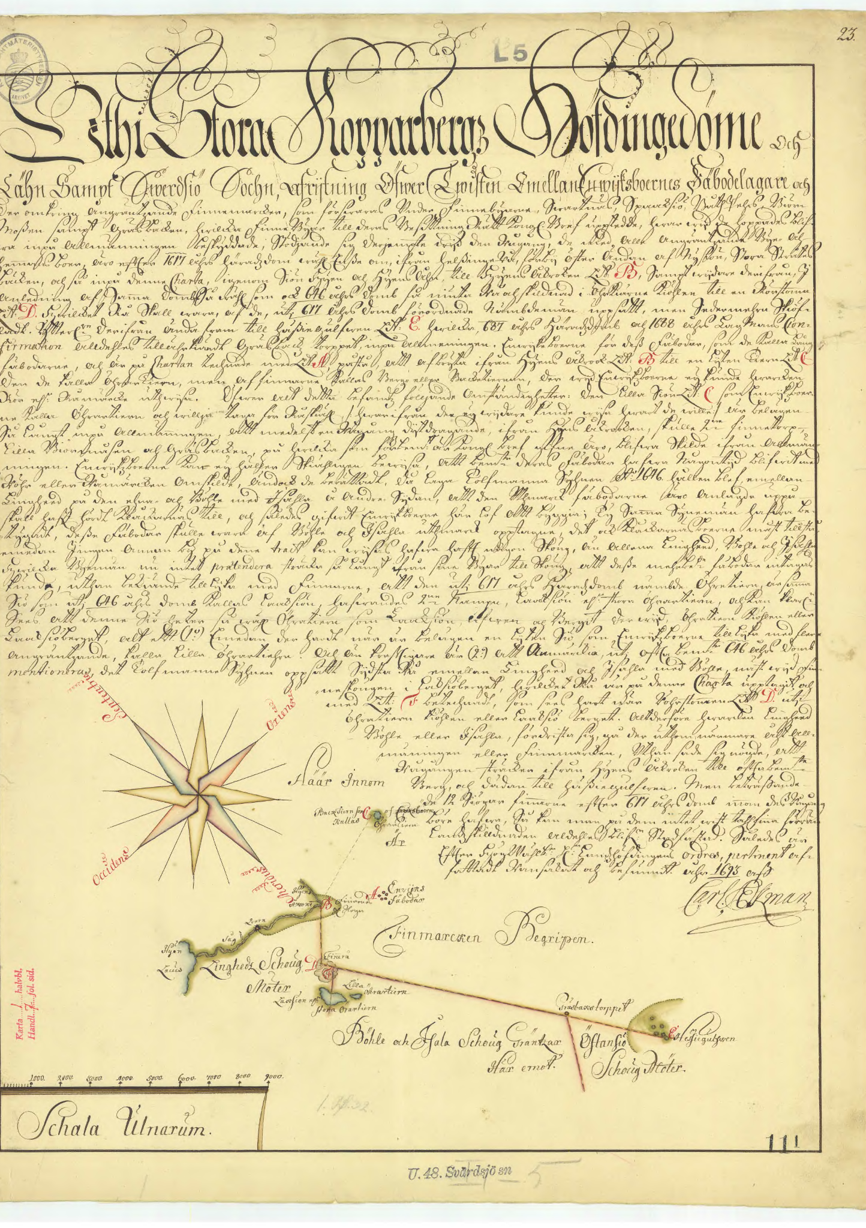
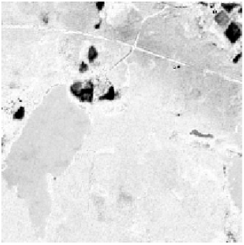
Image processing Computer vision
Notes:
For a quite

Slide 4
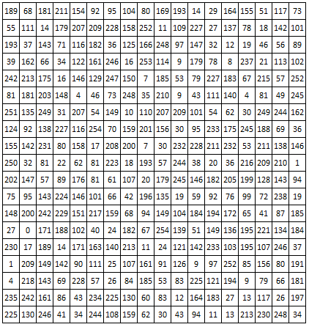
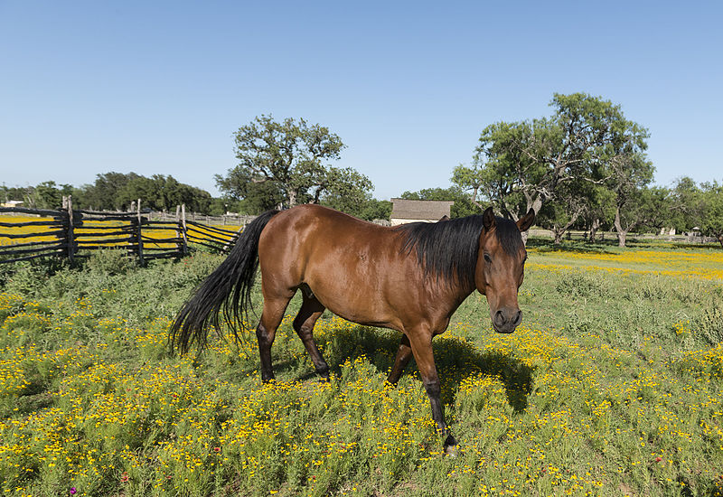
Eyesight Ability to se patterns, recognize objects and detect movements
Notes:
For a quite

Slide 5
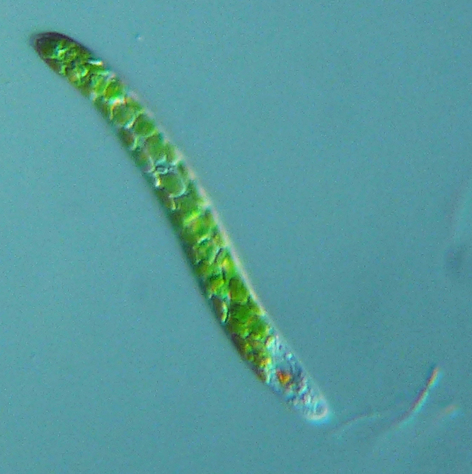
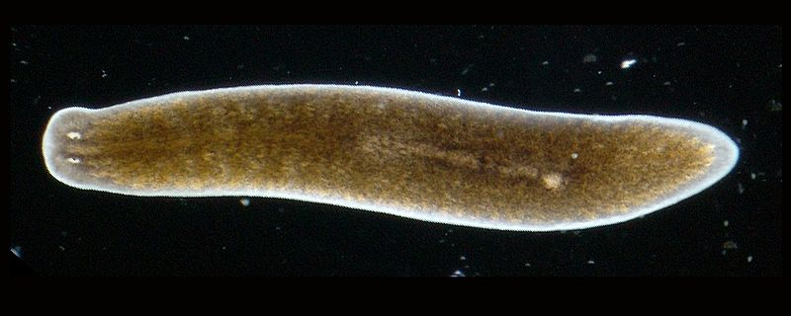
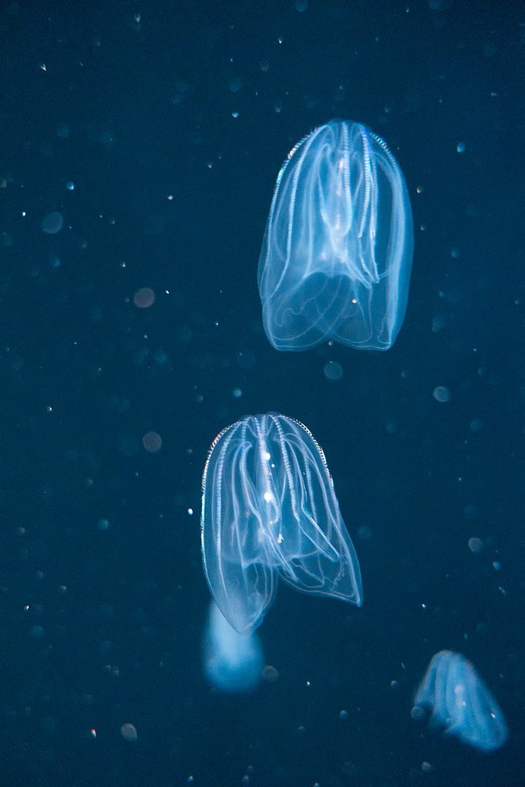
Planaria: Two collections of cup formed regions with proteins sensitive to light
Euglena: Proteins sensitive so sunlight. Now where to look for food
600 million years ago
Bell jelly fish: Reacts different on different colors. Green relax, purple flees.

Slide 6
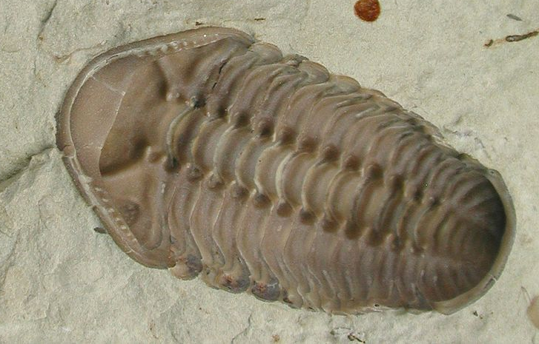
During this time of 15-35 million years many new species developetd. One hypothesis is that the delopment of eyes created a race between predators and pray.
If eyes was the cause of this race is hard to know, but cetainly it was a benefit to see.
Kainops invius: Trilobite developed during the cambrian explosion.
~520 mya – Cambrian explosion

Slide 7
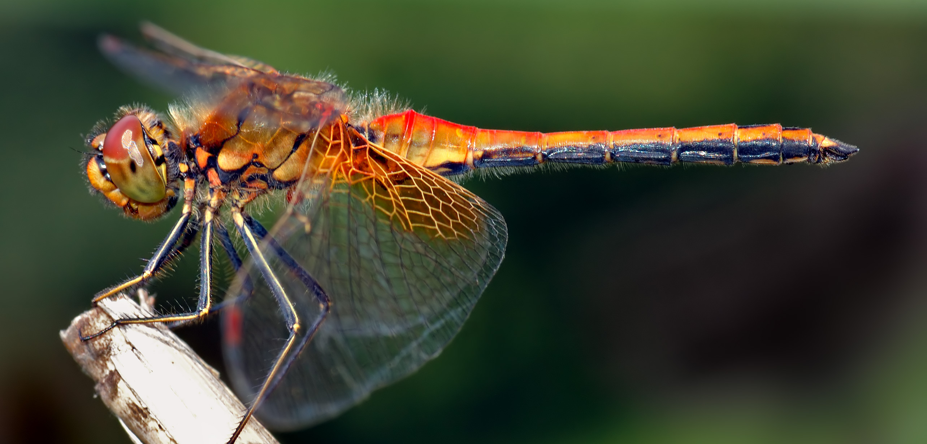
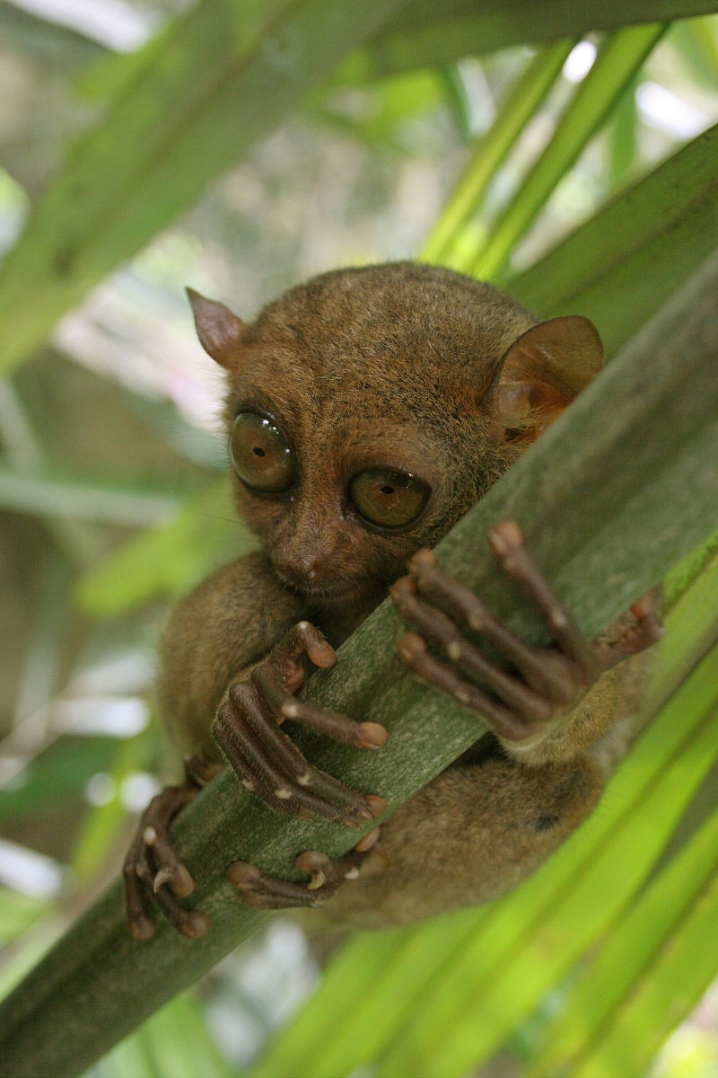
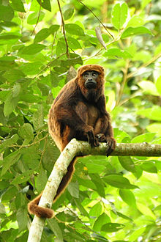
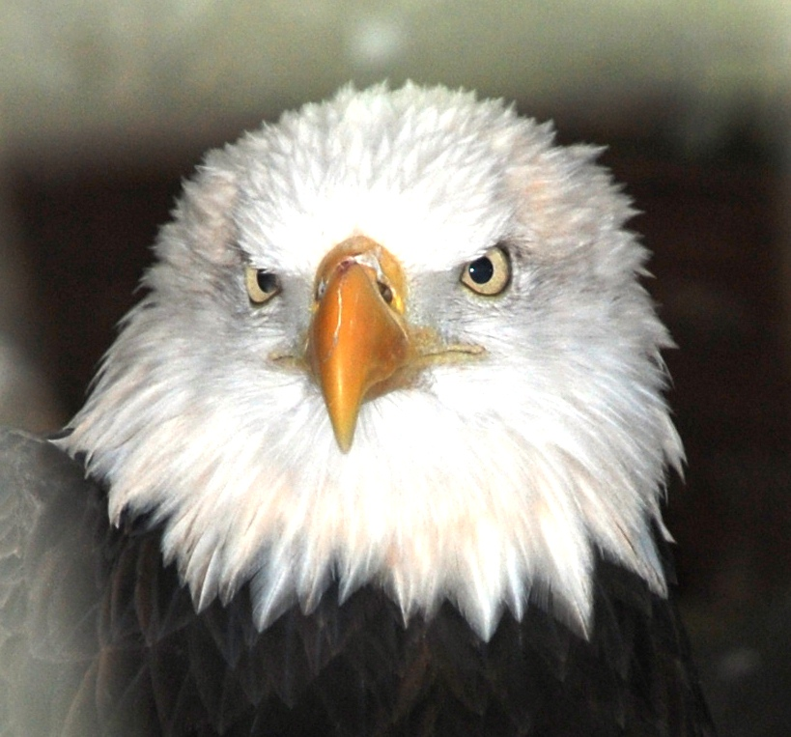
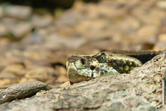
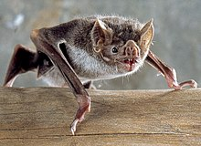
Dragonflies: 30’ photoreceptors with 360 degrees view. 5 times higer view frequenzy then humans. Uses motion camoflage when attacking.
Eagles: Can spot a rabbit from 3km. Eyes at size of a human
Primates: Developed receptors for red light. To distiguish nutrious fresh leavs.
Pit Viper: Beeing able to see temperature by hole close to nostril.
Tarsier: Eyes almost big its skull. Good night vision and binocular field
Different specializations of sight
Notes:
Egles has so tightly fitted eyes that they can barely move

Slide 8



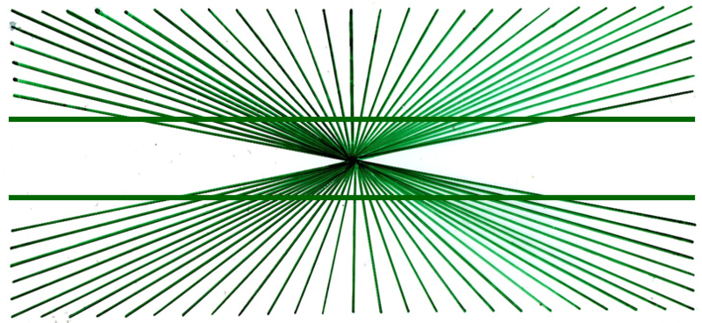
Processing of views
Notes:
Prata lite extra om elefanten som är ett tydligt exempel på att mänskliga hjärnan tittar på mönster som är nära varandra.

Slide 9
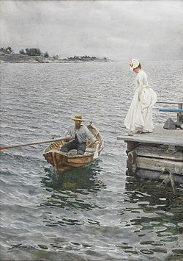
Feature extraction with convolution
Images needs to be converted to feature maps.
In Artificial Neural Nets convolutional layers are used to create those features
Anders Zorn – Sommarnöje 1886
Notes:
For a quite

Slide 10
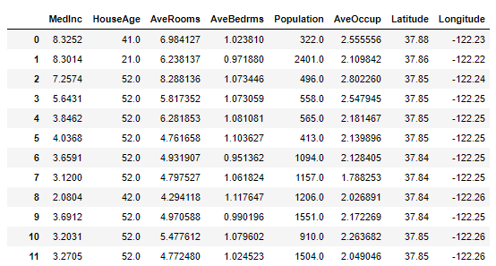
Difference between images and structured data
More important with nearby pixels similar with time dependent signals where measures close in time are more important.
Notes:
For a quite

Slide 11
Computers can take pictures
But computers doesn’t understand or see images just displays them.
The eye and brain where developed over 600milj years.
How can we make the computer understand what's in an image
Notes:
FoFrom Fei Fei Lei

Slide 12
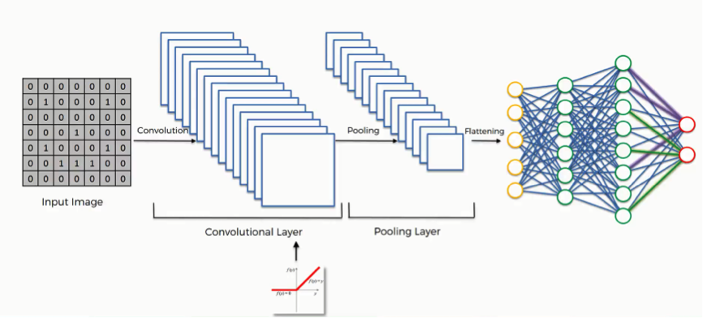
Principles of convolutional net

Slide 13

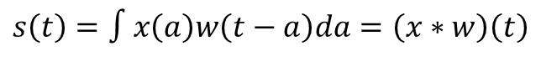
Convolution operator
Some mathematics (continuous):
$$s\left(t\right)=∫x\left(a\right)w\left(t−a\right)da=\left(x∗w\right)\left(t\right)$$
Notes:
For a quite

Slide 14
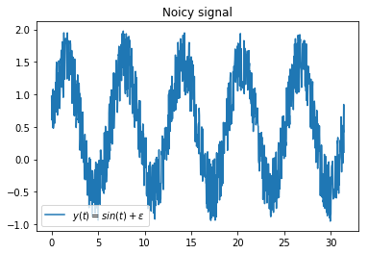
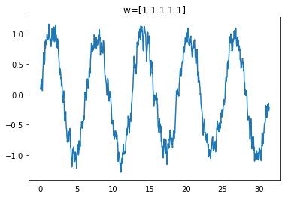
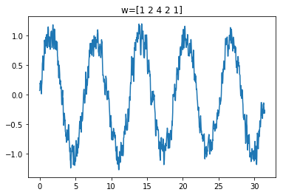
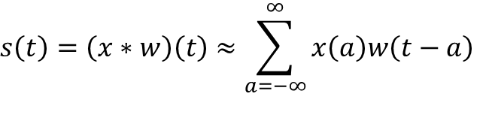
Convolution operator
Some mathematics (continuous):
$$s\left(t\right)=∫x\left(a\right)w\left(t−a\right)da=\left(x∗w\right)\left(t\right)$$
Discrete form:
$$s\left(t\right)=\left(x∗w\right)\left(t\right)≈\sum_{a=−∞}^{∞}{x\left(a\right)w\left(t−a\right)}$$
Notes:
For a quite

Slide 15
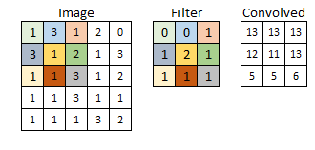
Convolution 2d
Notes:
For a quite

Slide 16
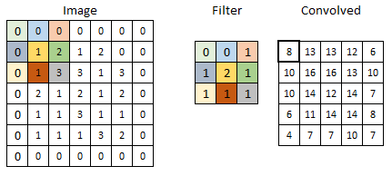
Convolution 2d – Zero padding
Notes:
For a quite

Slide 17
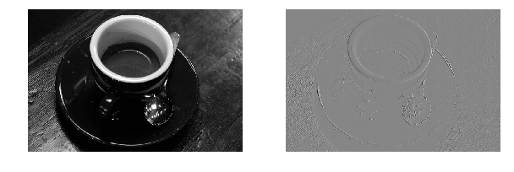
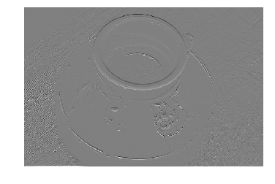
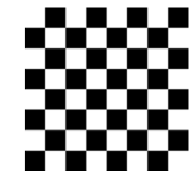
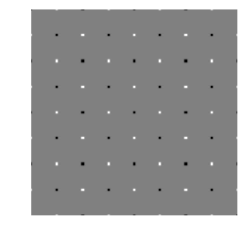
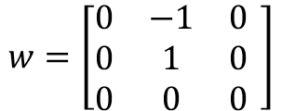
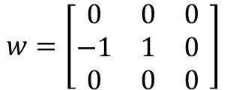
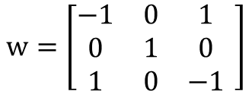
Examples of filters
$$w=\left[\begin{matrix}0 & 0 & 0 \\ −1 & 1 & 0 \\ 0 & 0 & 0\end{matrix} \right]$$
$$w=\left[\begin{matrix}0 & −1 & 0 \\ 0 & 1 & 0 \\ 0 & 0 & 0\end{matrix} \right]$$
$$w=\left[\begin{matrix}−1 & 0 & 1 \\ 0 & 1 & 0 \\ 1 & 0 & −1\end{matrix} \right]$$
Notes:
For a quite

Slide 18
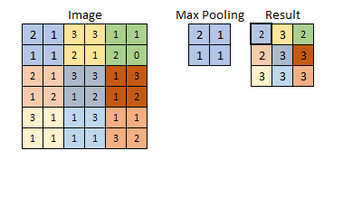
Pooling layer
Notes:
For a quite

Slide 19
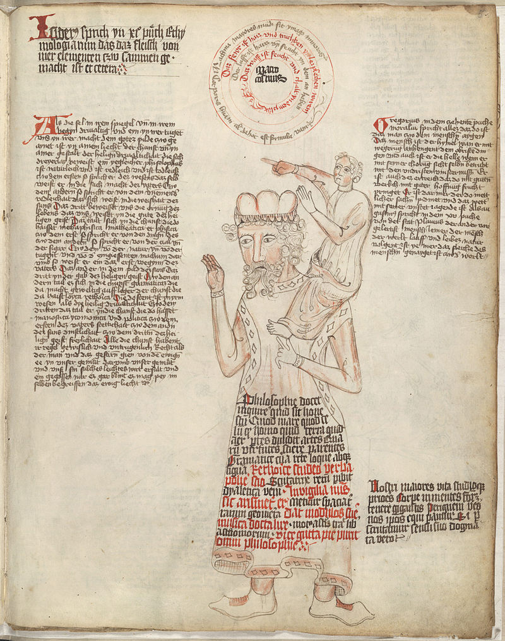
On the shoulders of Giants
Researches at Universities and large companies have invested a lot of time and money to develop good network designs and training those.
While developing those good networks a lot of designs has been evaluated and rejected.
It is always good to start the network from a network with trained wheights.
Training VGG16 from scratch takas a few days on GPU and weeks on CPU.

Slide 20
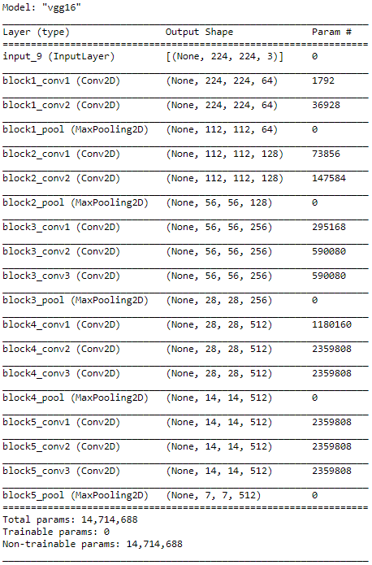
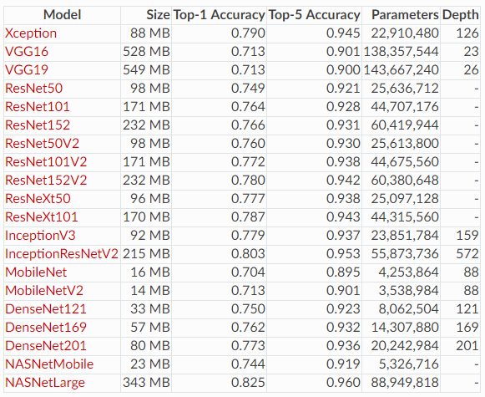
Models available in Keras
Notes:
For a quite

Slide 21
Different approaches
Notes:
For a quite

Slide 22
Lack of data - Data Augumentation
Modify images
Rotate
Zoom
Skew
Flip
Generate syntetic data
GDPR safe
Mathematicly describe symbols and create paths

Slide 23
Lets do some coding!
https://colab.research.google.com
Click on github – search for RegionVasterbotten
Click on repository AI-Lab-Neural-Net-and-Python
Need for google account
Using myBinder.org
No account needed
https://mybinder.org/
Search for RegionVasterbotten
OR
Use local repository

Slide 24
URLs
Stanford CS231
https://www.youtube.com/watch?v=LxfUGhug-iQ
Fei Fei Lei - TED
https://www.youtube.com/watch?v=40riCqvRoMs
Notes:
For a quite

